Slide 1
Q & A

Slide 2

Getting Started: Developing for Windows Phone
Rahul Pulikkot Nath
Consultant

Slide 3
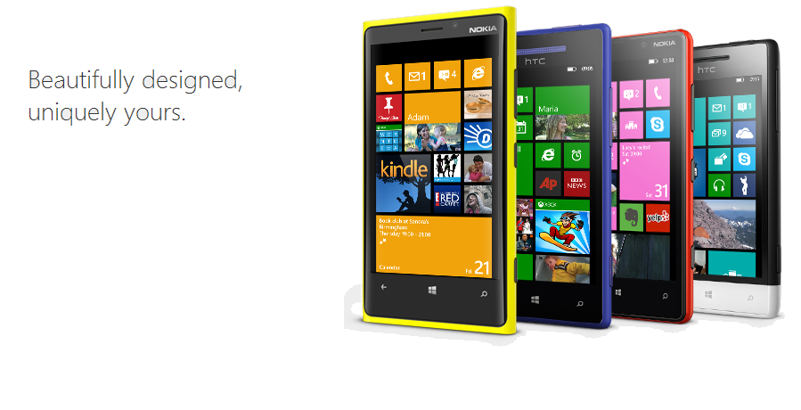

Slide 4
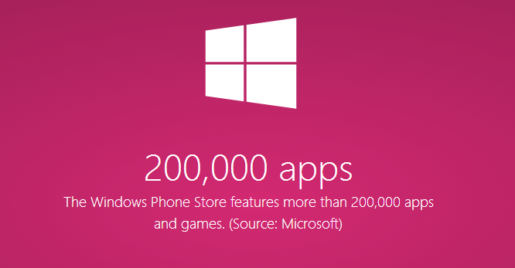
http://bit.ly/msbythenumbers

Slide 5


Slide 6

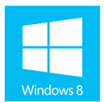

Get Started
developer.windowsphone

Slide 7
Account types, locations and fees
Individual Account
Company Account
http://bit.ly/wpaccounttypes

Slide 8
XAML (Extensible Application Markup Language)
Declarative language
Primary format for declaring a Windows Phone UI and elements in that UI

Slide 9
StackPanel helloWorld = new StackPanel() { Name = "helloWorld" };
TextBlock hello = new TextBlock() { Text = "Hello" };
TextBlock world = new TextBlock() { Text = "World" };
helloWorld.Children.Add(hello);
helloWorld.Children.Add(world);

Slide 10
StackPanel helloWorld = new StackPanel() { Name = "helloWorld" };
TextBlock hello = new TextBlock() { Text = "Hello" };
TextBlock world = new TextBlock() { Text = "World" };
helloWorld.Children.Add(hello);
helloWorld.Children.Add(world);
<StackPanel Name="helloWorld">
<TextBlock>Hello</TextBlock>
<TextBlock>World</TextBlock>
</StackPanel>

Slide 11
File

Slide 12
File -> New

Slide 13
File -> New -> Project

Slide 14
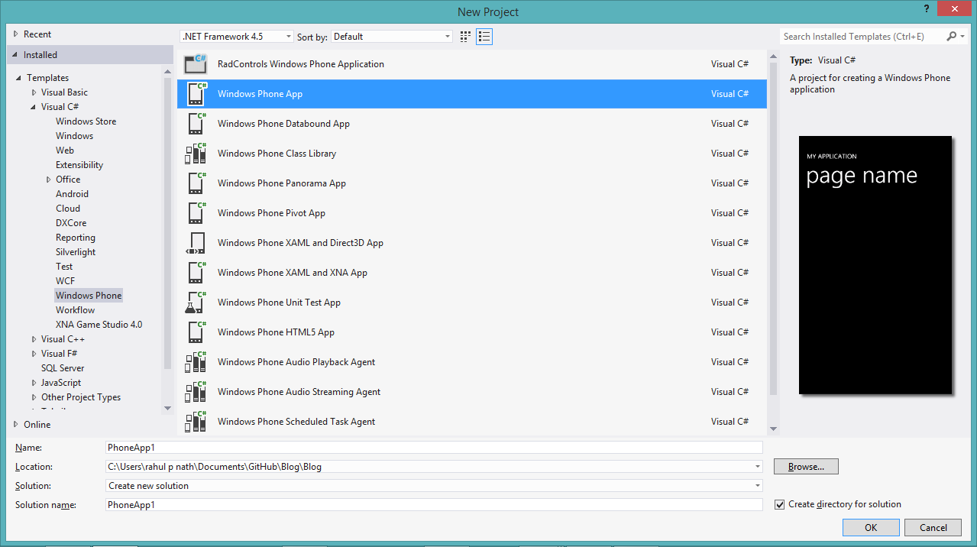

Slide 15
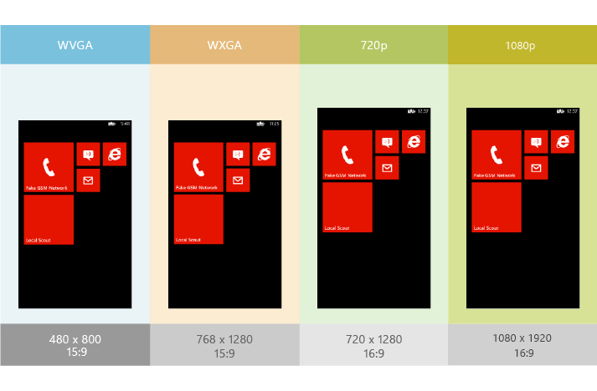
Emulators
Notes:
http://msdn.microsoft.com/en-us/library/windowsphone/develop/jj206974(v=vs.105).aspx

Slide 16
Developing for Multiple resolution
Adaptive Layout
Height & Width
http://bit.ly/wplayout

Slide 17
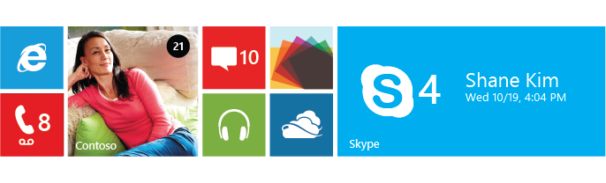
Tiles
image that represents your app on the Start screen
Default tile and Secondary tile

Slide 18
… And making them Live
Engage more with the user
Real Time information and updates
http://bit.ly/wplivetiles

Slide 19
How?
Push Notifications
Local Notifications

Slide 20
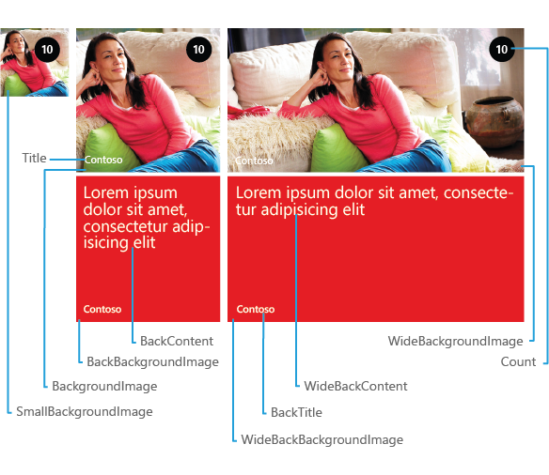
Flip Tile Template

Slide 21
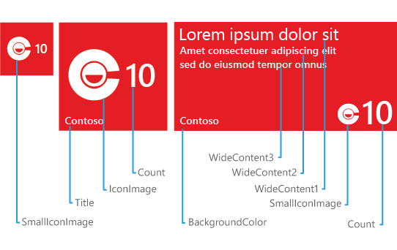
Iconic Tile Template

Slide 22
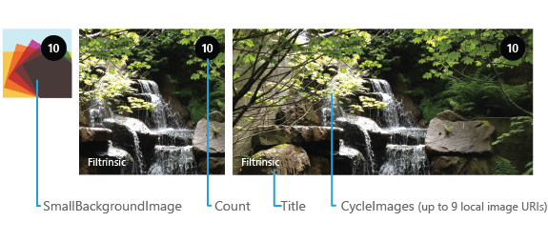
Cycle Tile Template

Slide 23
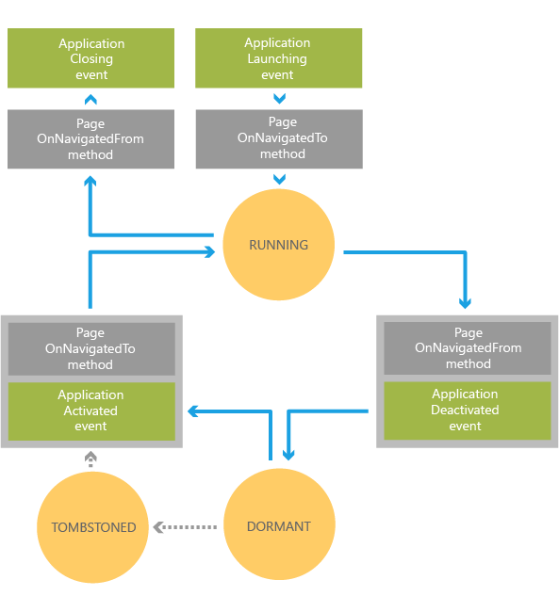
Application Lifecycle
http://bit.ly/wpapplifecycle

Slide 24
M -V - VM
(Model - View – ViewModel)

Slide 25
Why MVVM
cleanly separate the business and presentation logic of your application from its user interface
Improves code re-use
Easier to test, maintain and evolve

Slide 26
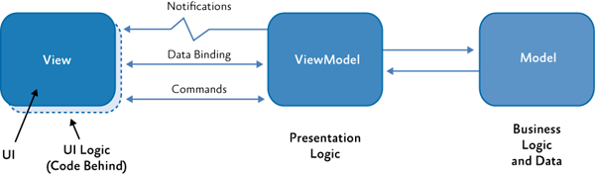

Slide 27
App Distribution
Deploying to a single/multiple devices
Windows Phone Store
Private Beta
Company Apps Deployment

Slide 28
Store Submission
App Name
Screenshots
Privacy/Terms of use
Location
… And a lot more
http://bit.ly/wpcertificationreq

Slide 29
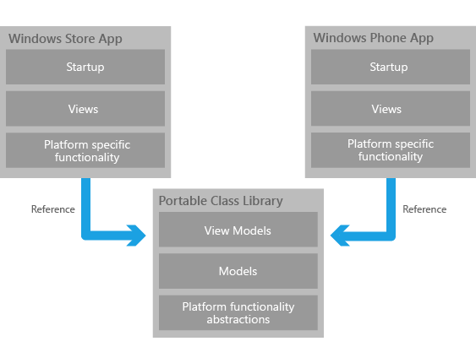
Windows Phone & Windows 8 ...
http://bit.ly/wp8w8

Slide 30
Getting Started: Developing for Windows Phone and Windows 8
Rahul Pulikkot Nath
Consultant

Slide 31
... And More Platforms
Xamarin
PhoneGap/Apache Cordova
Sencha
Appcelerator
…Many more
Notes:
These are just randomly picked platforms. There might be better platforms out there possibly better than this.

Slide 32
What Next?
Microsoft Virtual Academy
DVLUP
Interoperability
Programming Windows Phone (free e-book)

Slide 33
Q & A

Slide 34
Stay Healthy,
Code Well
and Keep
in touch
@rahulpnath
http://rahulpnath.com

